Slide 1

SMS SPAM CLASSIFICATION USING DEEP LEARNING
Prem Sai Nayudu: 700759816
Author: Sridevi Gadde, A. Lakshmanarao, S. Sathyanarayana
https://ieeexplore.ieee.org/document/9441783
https://github.com/PremSai98160/NNDL_Project

Slide 2
Motivation
In the digital age, the proliferation of spam messages poses significant challenges to individual productivity and security. Leveraging Deep Learning techniques for spam message classification not only enhances our ability to filter out irrelevant and potentially harmful content efficiently but also improves user experience by ensuring that vital communications reach their intended recipients without delay. By applying deep learning , we can automate and refine the detection of spam, adapting to evolving tactics used by spammers and protecting users from unwanted intrusions into their digital communications.

Slide 3
Problem Statement
The increasing volume and sophistication of spam messages circulating through digital communication channels present significant challenges in maintaining the efficiency, privacy, and security of online interactions. This project aims to develop a robust spam detection system using advanced deep learning techniques, LSTM, and machine learning algorithms, specifically Random Forest classifiers, to accurately identify and filter out spam messages. By leveraging feature extraction and employing an automated classification model, the system will enhance the ability to protect users from unsolicited and potentially harmful content, thereby ensuring the integrity and reliability of digital communications.

Slide 4
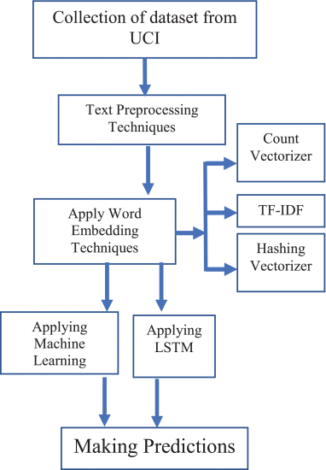
Objectives

Slide 5
Proposed Solution
•Collection of Dataset from UCI
•Data Analysis
•Feature Engineering
•Data Cleaning
•Model Building & Comparison
•Making Predictions

Slide 6
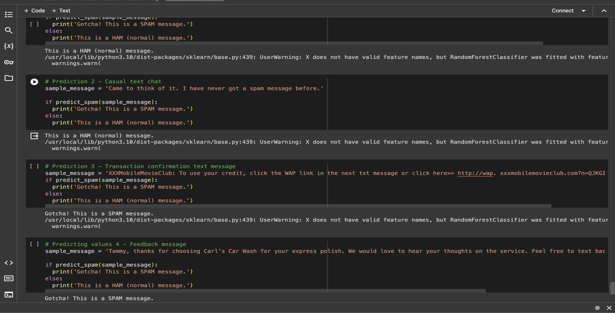
Results

Slide 7
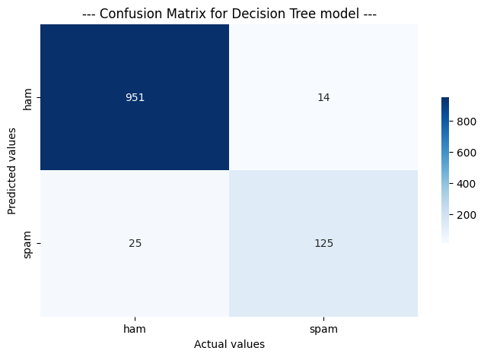



Slide 8
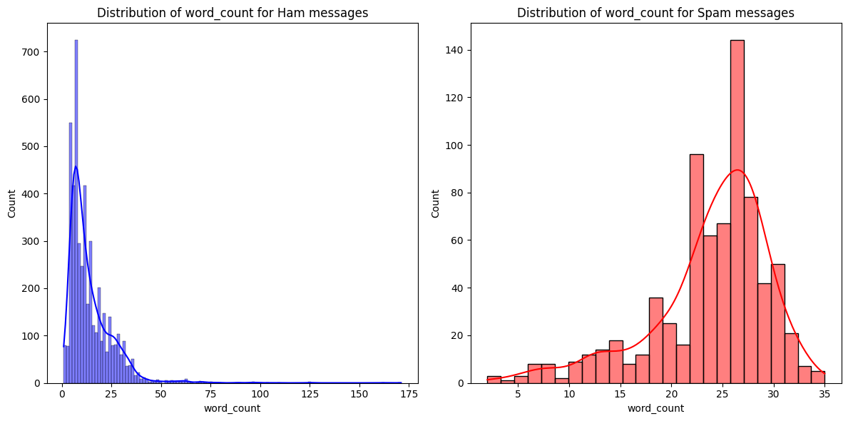
HAM msgs VS Spam Msgs

Slide 9
References
T. Jain, P. Garg, N. Chalil, A. Sinha, V. K. Verma and R. Gupta, "SMS Spam Classification Using Machine Learning Techniques," 2022 12th International Conference on Cloud Computing, Data Science & Engineering (Confluence), Noida, India, 2022, pp. 273-279, doi: 10.1109/Confluence52989.2022.9734128. keywords: {Support vector machines;Machine learning algorithms;Costs;Machine learning;Probability;Message service;Natural language processing;Spam detection;SMS spam;machine learning},
S. V P, V. V, K. R and T. T. T, "Performance Comparison of Machine Learning Algorithms in Short Message Service Spam Classification," 2023 2nd International Conference on Advancements in Electrical, Electronics, Communication, Computing and Automation (ICAECA), Coimbatore, India, 2023, pp. 1-4, doi: 10.1109/ICAECA56562.2023.10199265. keywords: {Support vector machines;Training;Logistic regression;Machine learning algorithms;Forestry;Filtering algorithms;Message services;SMS spam detection;spam filtering;machine learning;random forest;classification},
A. Kumar and C. Fancy, "Enhancing Security in SMS by Combining NLP Models Using Ensemble Learning for Spam Detection with Image Steganography Integration," 2023 2nd International Conference on Edge Computing and Applications (ICECAA), Namakkal, India, 2023, pp. 583-586, doi: 10.1109/ICECAA58104.2023.10212103. keywords: {Support vector machines;Steganography;Machine learning algorithms;Computational modeling;Receivers;Feature extraction;Natural language processing;Natural Language Processing;Ensemble Learning;Spam Detection;Image Steganography},
P. Joseph and S. Y. Yerima, "A comparative study of word embedding techniques for SMS spam detection," 2022 14th International Conference on Computational Intelligence and Communication Networks (CICN), Al-Khobar, Saudi Arabia, 2022, pp. 149-155, doi: 10.1109/CICN56167.2022.10008245. keywords: {Support vector machines;Unsolicited e-mail;Digital communication;Communication networks;Organizational aspects;Random forests;Computational intelligence;Spam detection;machine learning;word embedding;bag-of-words;term frequency-inverse document frequency;n-grams;word2vec;doc2vec},
K. Debnath and N. Kar, "Email Spam Detection using Deep Learning Approach," 2022 International Conference on Machine Learning, Big Data, Cloud and Parallel Computing (COM-IT-CON), Faridabad, India, 2022, pp. 37-41, doi: 10.1109/COM-IT-CON54601.2022.9850588. keywords: {Deep learning;Support vector machines;Radio frequency;Unsolicited e-mail;Computational modeling;Bit error rate;Data preprocessing;Email Spam detection;Deep Learning;Machine Learning;LSTM;BERT},

